Slide 1

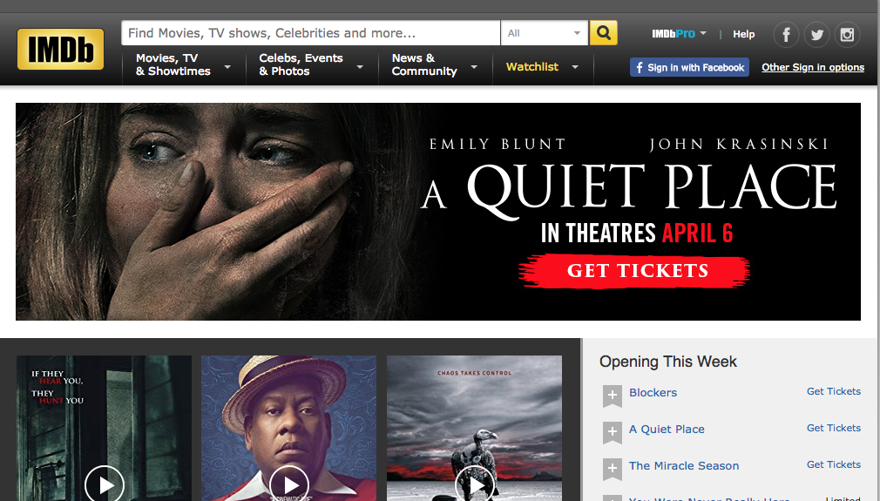
Project Tomahawk
IMDB
April 4, 2018

Slide 2
Outline
Data Collection
Data Cleaning
EDA
Topic Modeling

Slide 3
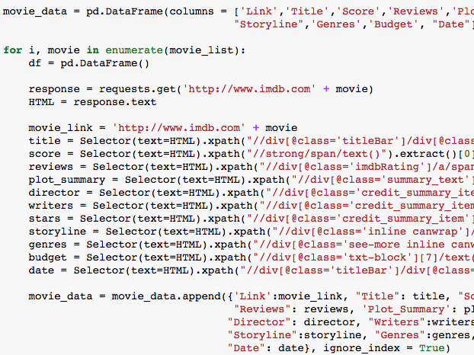
Data Collection
1
Data was collecting using scrapy in python.
Data was scraped for the top 200 movies from every genre.
After cleaning and removing duplicates 1232 movies were left in our data set.

Slide 4
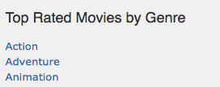
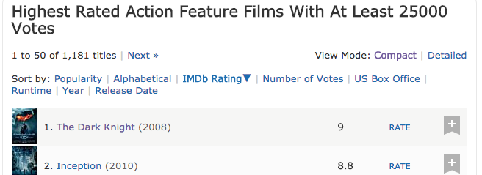
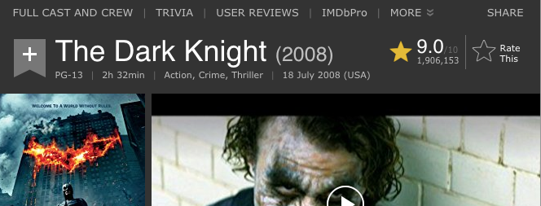
Scrapy Process
List of genre top move pages
Collected links to genre top movie pages
For every genre link: collected links to top 200 movies and added movie links to a list
Removed duplicates from movie link list
For every movie link: went to movie page and collected scraped data
Link to top action
movies list
“Top Action Movies” Page
Link to The Dark Knight Movie page
“The Dark Knight” Movie Page
The Dark Knight Movie Score

Slide 5
Fields and Descriptions
Scraped from IMDB
Date: release Date of the Film
Link: Link the the Film’s IMDB page
Reviews: number of reviews
Score: average review score
Budget: Film budget in USD
Storyline: Film Plot
Plot Summary: summarized Storyline
Directors: list of Directors
Genres: List of Genres the movie falls into
Writers: List of Writers
Stars: List of Stars
Created from IMDB Fields
Director 1:First Director listed in Directors
Similar Fields: Director 2
Writer 1: First Writer listed in Writers
Similar Fields: Writer 2
Star 1: First Star listed in Stars
Similar Fields: Star 2, Star 3
Action: 1 if “Action” in Genres, 0 if not
Similar Fields: Adventure, Animation, Biography, Comedy, Crime, Drama, Family, Fantasy, Film-Noir, History, Horror, Music, Musical, Mystery, Romance, Sci-Fi, Sport, Thriller, War, Western

Slide 6
Data Cleaning
Removed Movies whose budgets we’re in USD
Replaced non ascii characters from all text fields
Non ascii Character example: ñ, å, ó
Changed list types to a strings with commas separating items
Ex. [‘writer A’, ‘writer B’] became “writer A, writer B”
Changed all fields to the correct data types
Ex. Changed Budget from a string to numeric

Slide 7
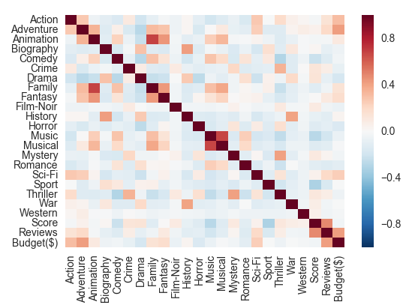
Exploratory Data Analysis
1
Stats for score, reviews, and Budget
Correlation with Score
Focus on Genres
Storyline Analysis

Slide 8
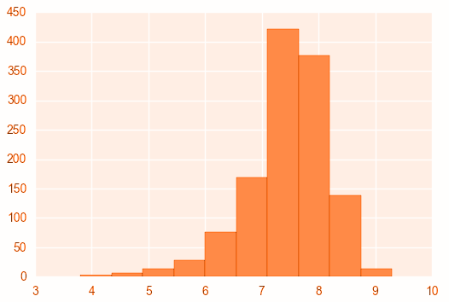
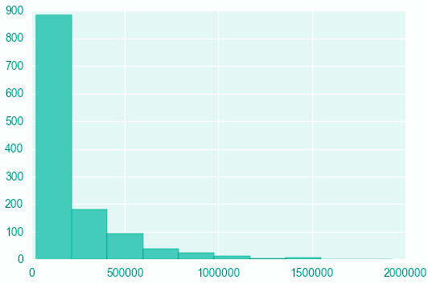
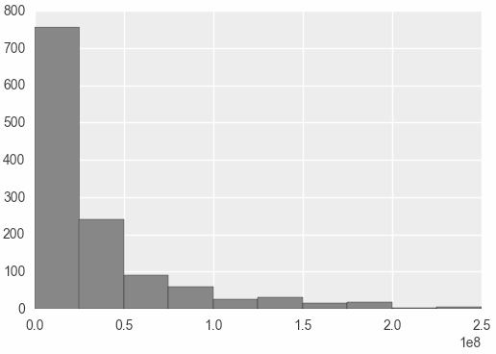
Score, Reviews, and Budget
Score
Mean: 7.44
25%: 7.10
50%: 7.60
75%: 7.90
Min: 3.80
Max: 9.30
Reviews
Mean: 204,435
25%: 50,960
50%: 106,821
75%: 255,982
Min: 25,143
Max: 1,930,551
Budget
Mean: $33,650,212
25%: 7.10
50%: 7.60
75%: 7.90
Min: 3.80
Max: 9.30

Slide 9
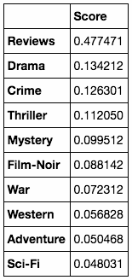
Score Correlation
Drama and Crime are the Genres with the highest correlation with Score.
Review and Score have a strong correlation.
Budget has a slightly negative correlation with Score.

Slide 10
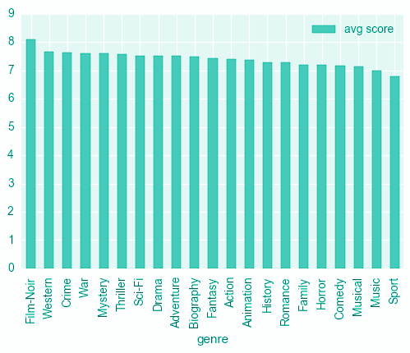
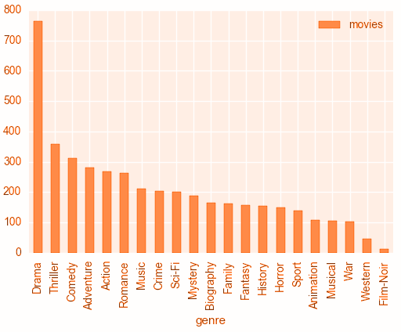
Genres
Avg Score by Genre
Movies by Genre

Slide 11
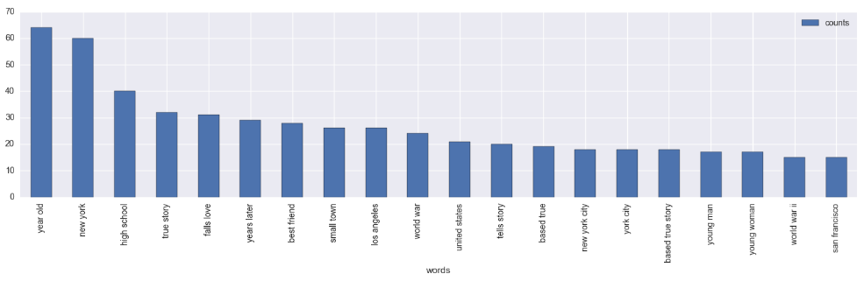
Storyline
Top Phrases in Storylines
Excluding English Stop Words (A, The, …)

Slide 12
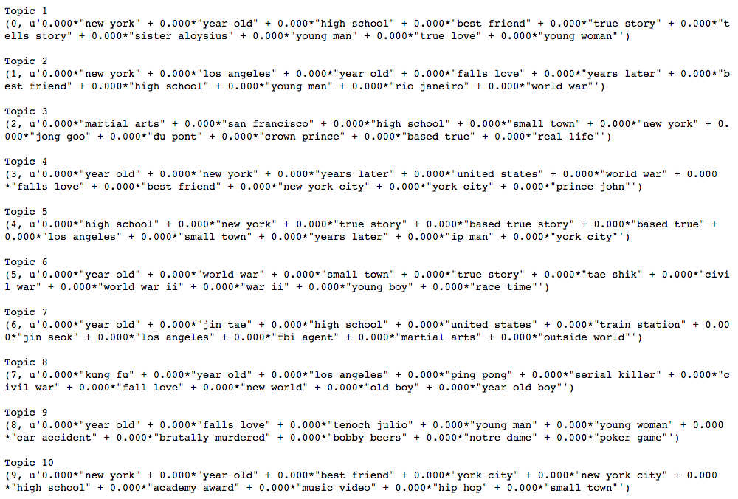
Storyline LDA Topics

Slide 13
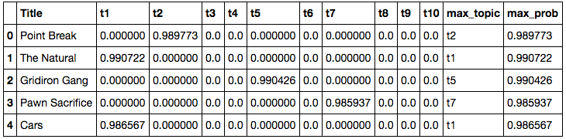
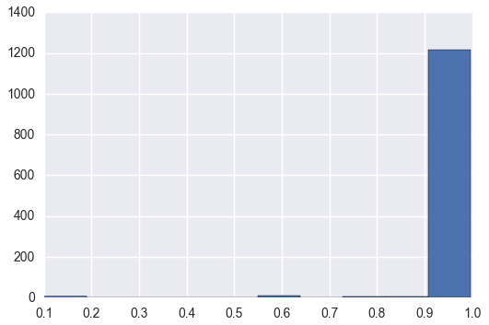
Storyline LDA Topics
For every storyline the probability of each topic being in the storyline was calculated.
The Storylines had high probabilities in single topics instead of low to medium probabilities in all topics

Slide 14
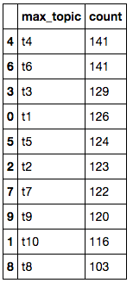
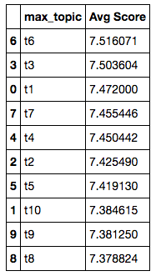
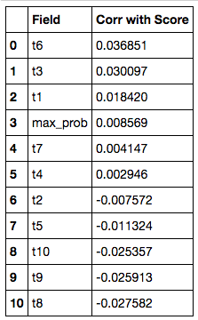
Storyline LDA Topics
Movies by Topic
Avg Score by Topic
Correlation with Score by Topic

Slide 15
Thank You

